Slide 1
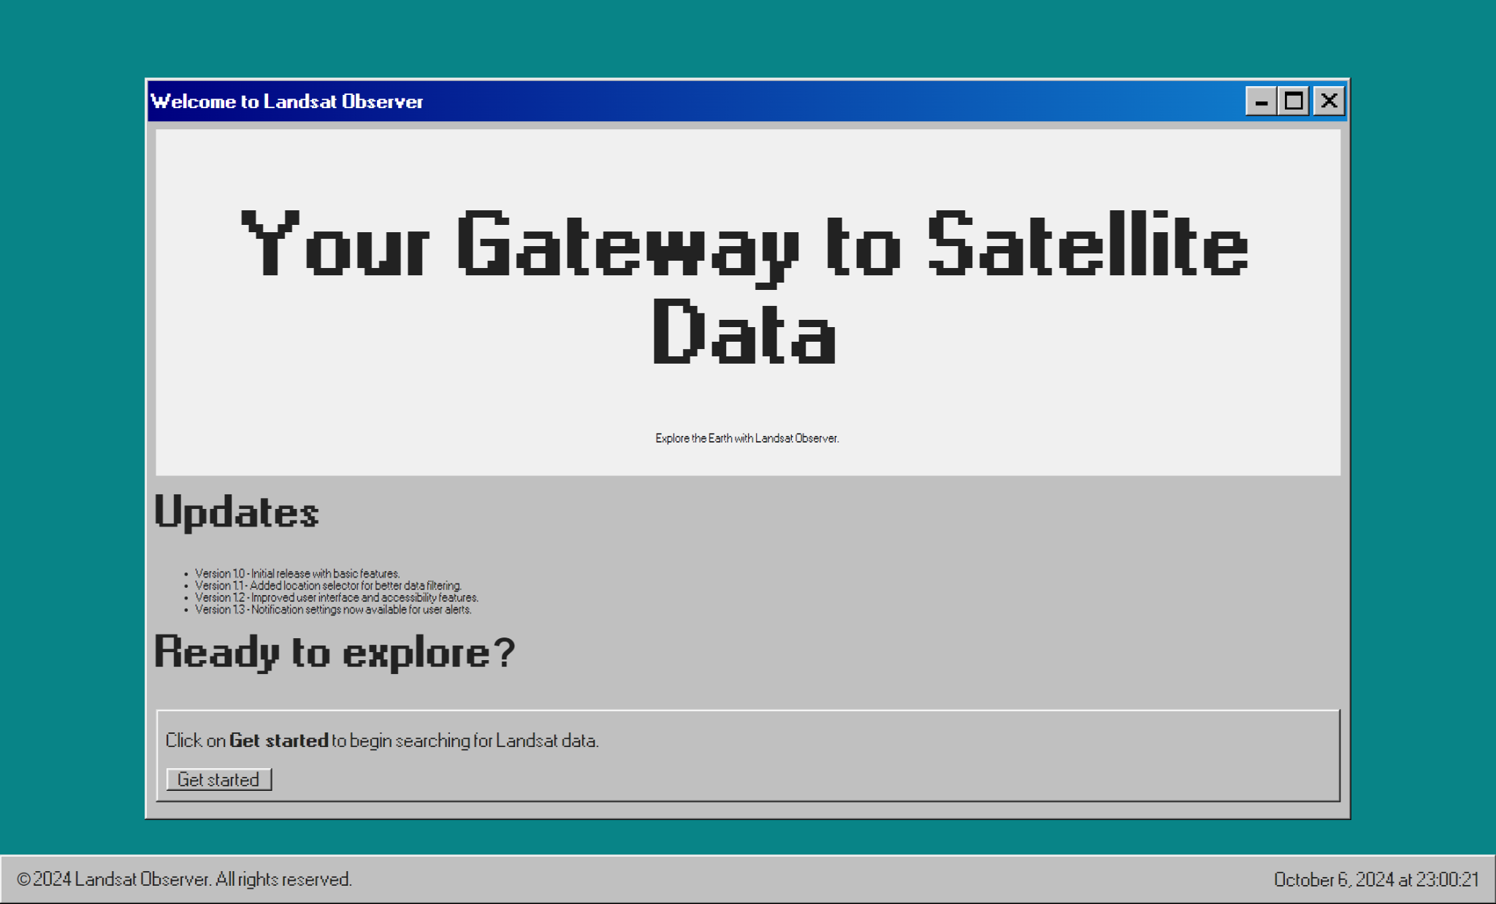
“Clickable ‘Get started’ button takes you to interactive map.”

Slide 2
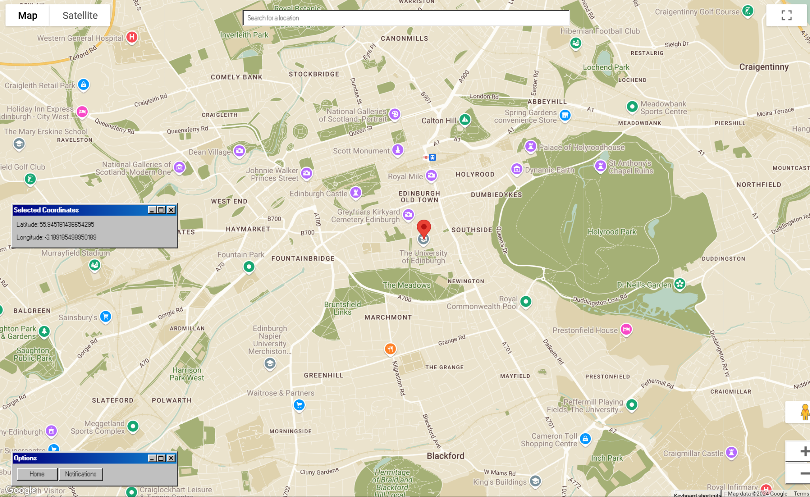
“Or you may use this search bar to input an address directly.”
“Your current selected coordinates are displayed here.”
“Drag and drop the marker on the map; coordinates are updated in real-time.”
“Options allow you to return to the landing page (prev. slide), or, when you have confirmed your coordinates, the Notifications Settings page.”

Slide 3
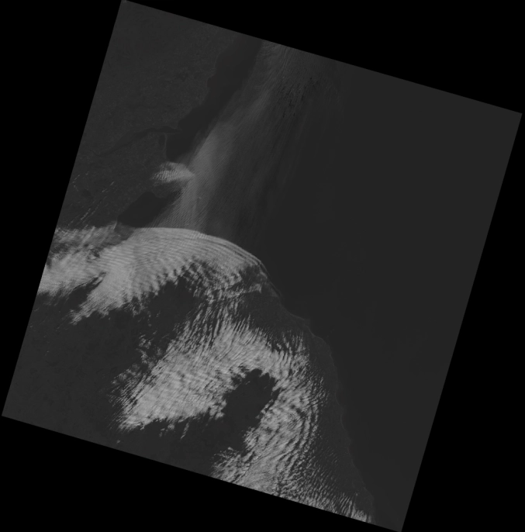
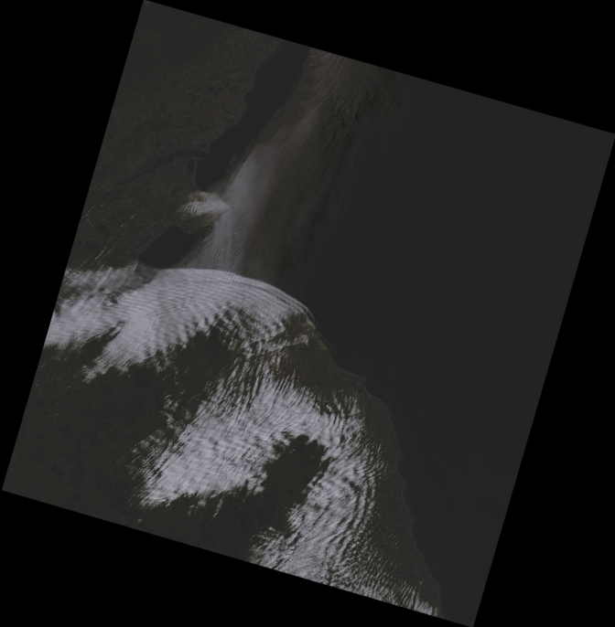

“The separate bands were stacked using rasterio to create a composite image with multiple layers.”
“The combined bands formed a full-color image, visualizing the satellite data in natural colors.”
“By combining Band 4 (Red), Band 3 (Green), and Band 2 (Blue), a natural-color image is created, mimicking how the human eye sees the landscape, enabling clearer interpretation of surface features.”

Slide 4
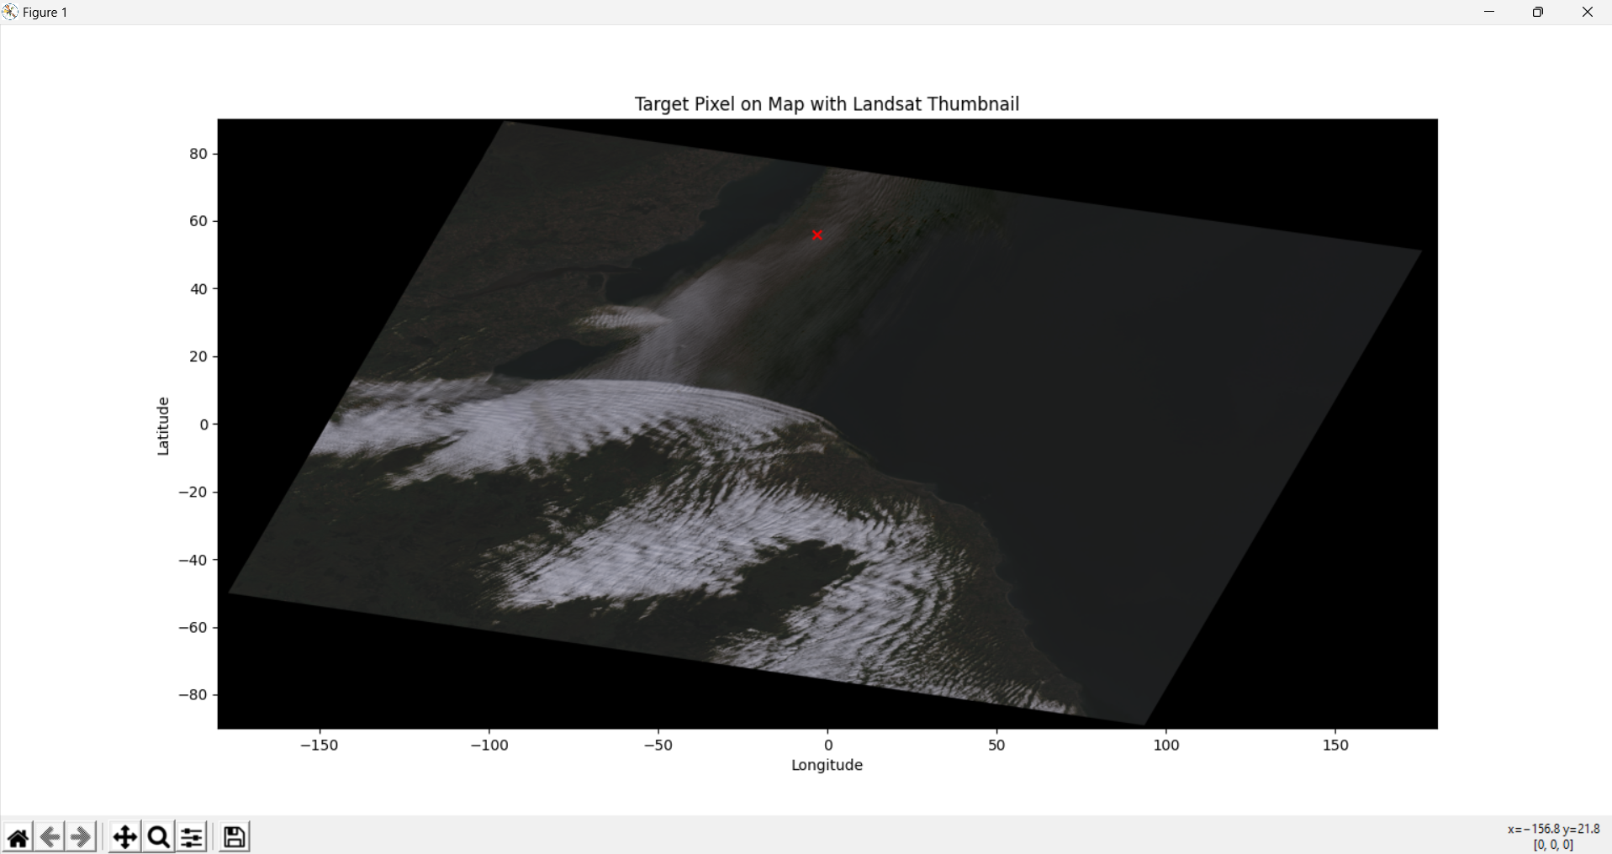
“Plotting Pixel on Map: Using the composite image, a specific pixel (latitude and longitude) is plotted on retrieve images, helping pinpoint exact locations and visualize their context in relation to the rest of the landscape. This helps in identifying and analyzing specific geographic points.”

Slide 5
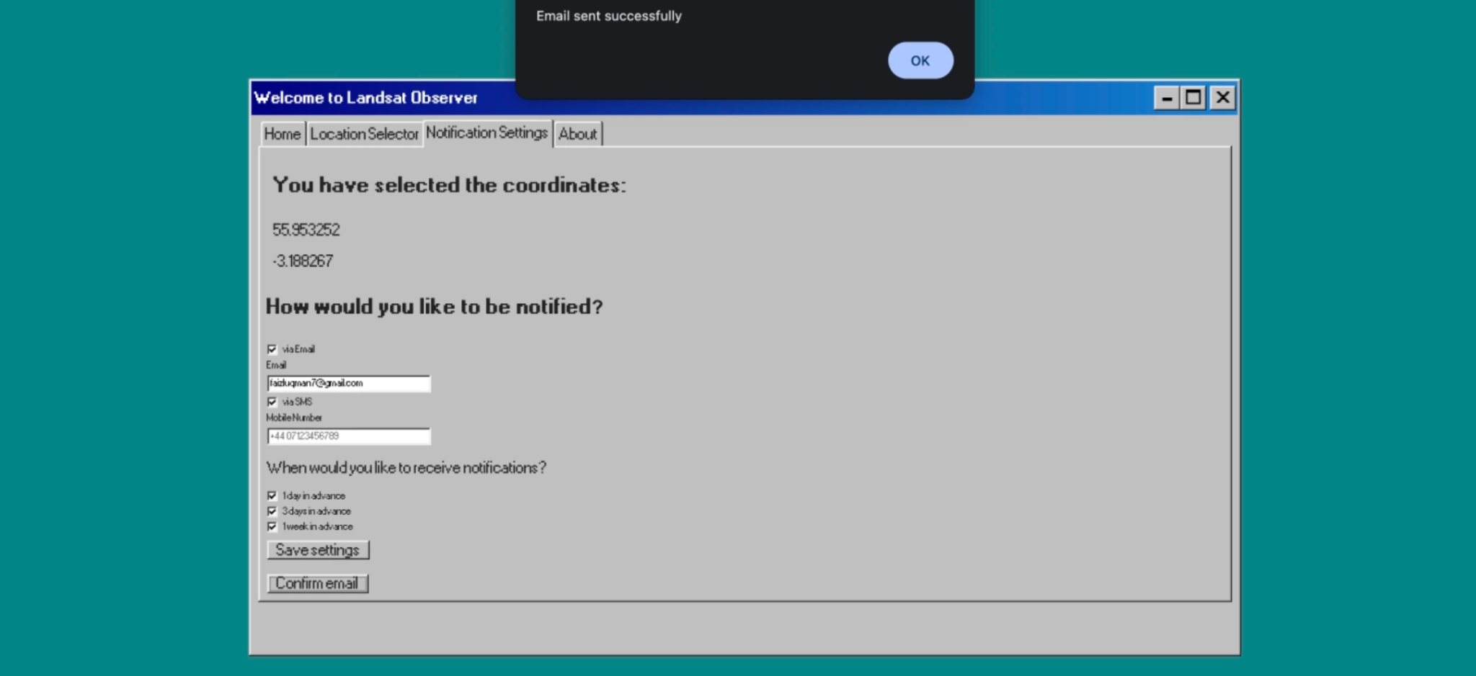
“You may input your email and a confirmation email will be sent.”

